Slide 1
Measurement of atom resolvability in cryo-EM maps with Q-scores
林思涵
2022/12/22

Slide 2
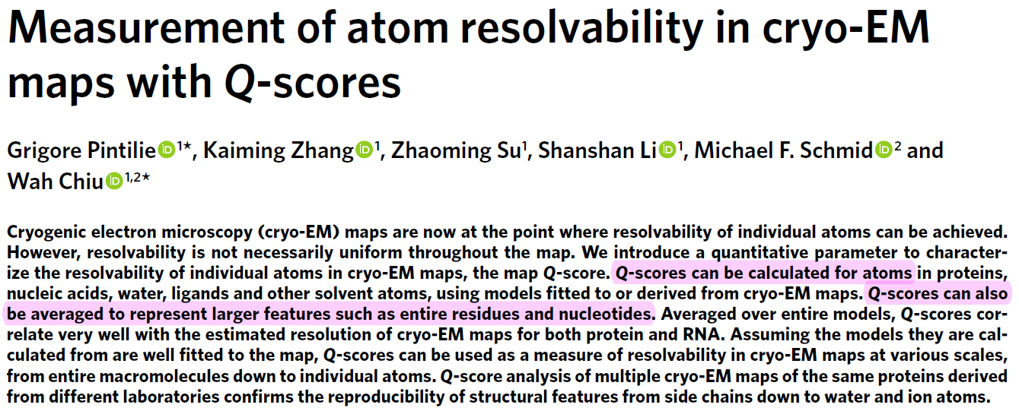

Slide 3
Background

Slide 4
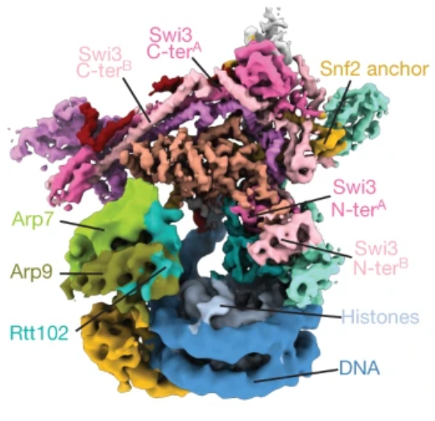
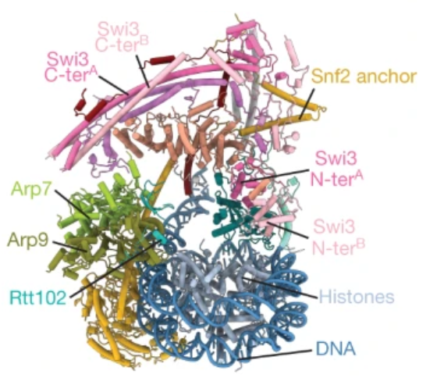
Cryo-EM structure and Protein structure

Slide 5
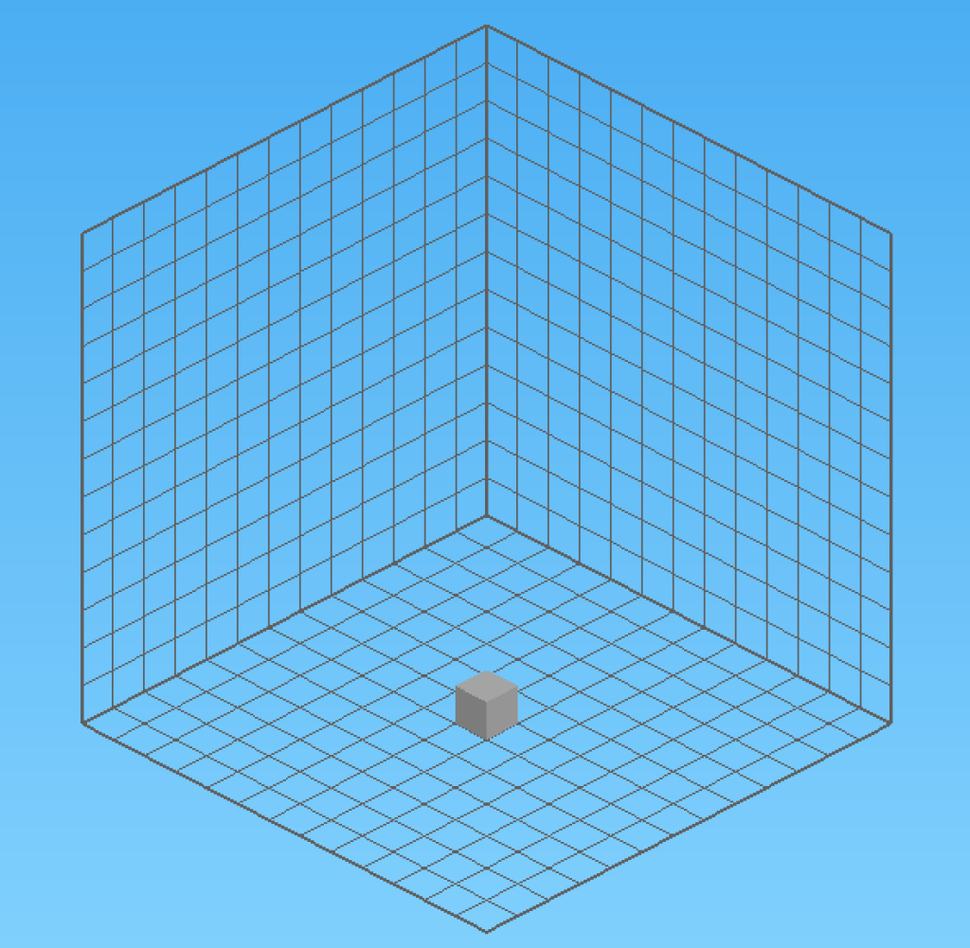
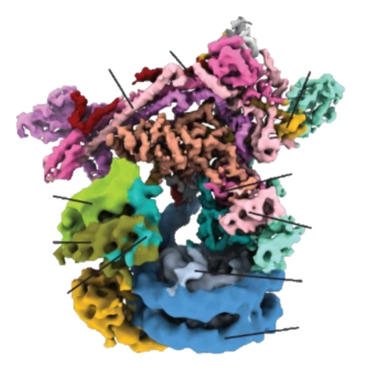
Cryo-EM structure (Cryo-EM map)
每一個voxel都有一個average map value
♠ 不同工具做出來的Cryo-EM map
（relion、cryosparc)
♥ average map value的range可能不一樣！
（但相對數值的高低可能是差不多的）

Slide 6
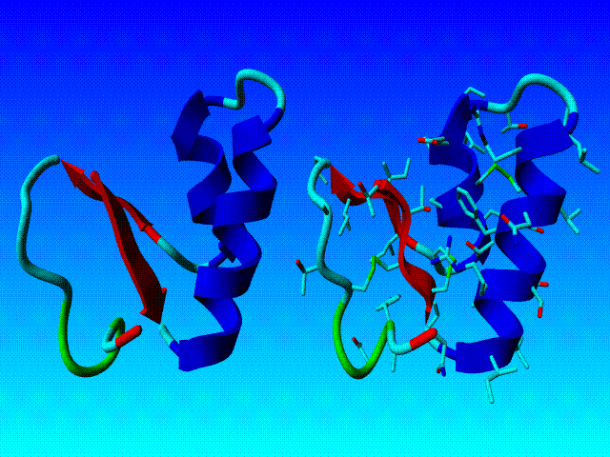
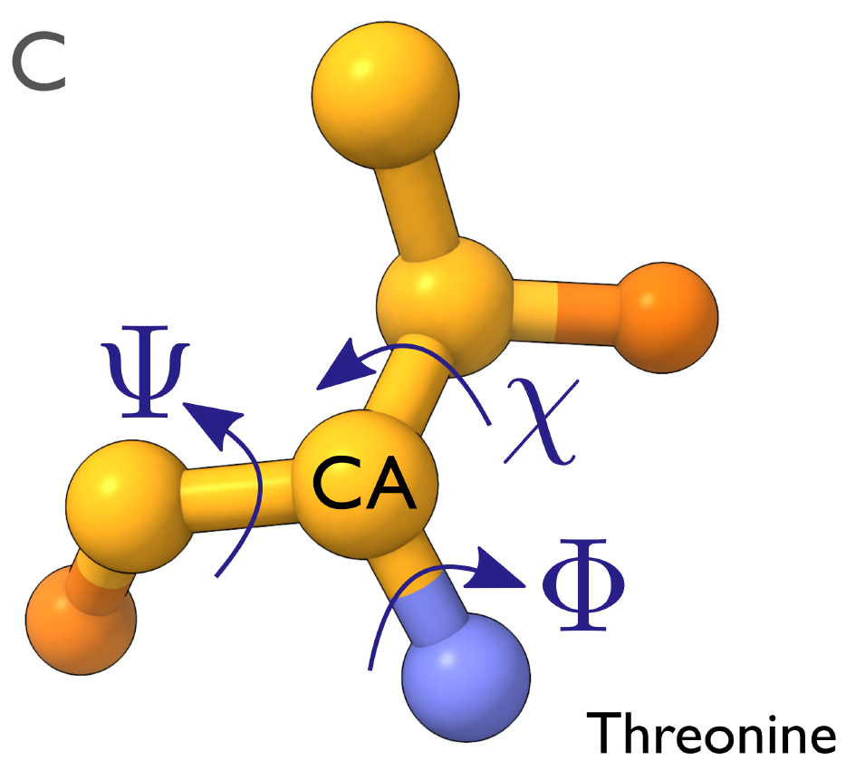
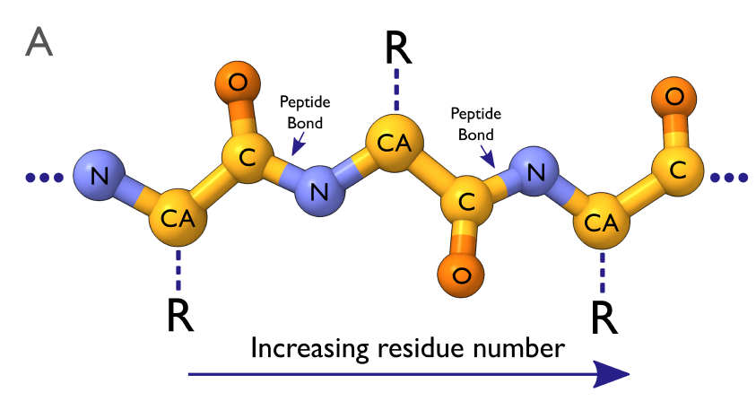
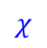






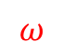
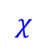
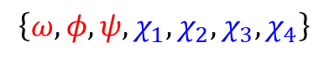
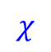
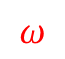
Background Knowledge
Backbone
$$\left\{ω,φ,ψ,χ_{1},χ_{2},χ_{3},χ_{4}\right\}$$
Torsion Angle
$$χ$$
$$φ$$
$$φ$$
$$ψ$$
$$φ$$
$$ψ$$
$$ω$$
$$ω$$
$$ψ$$
$$χ$$
$$χ$$

Slide 7
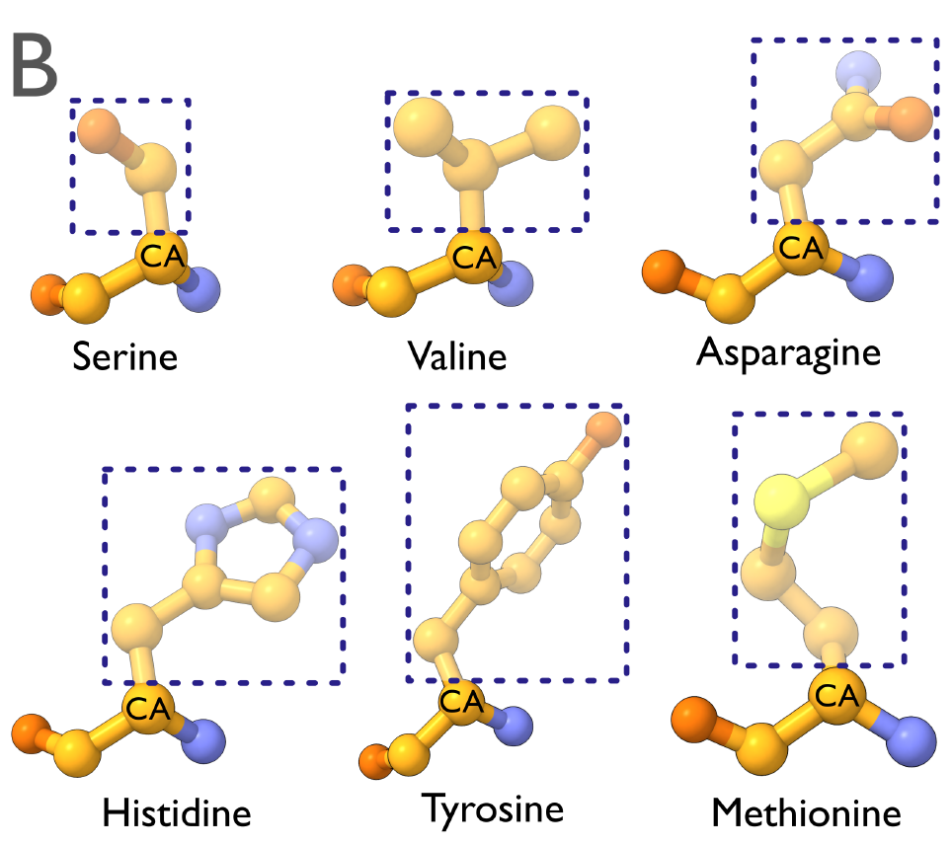
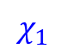

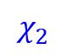
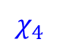
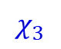
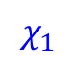
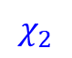
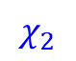

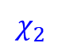
Background Knowledge
Torsion Angle
$$\left\{ω,φ,ψ,χ_{1},χ_{2},χ_{3},χ_{4}\right\}$$
Residue (Side chain)
Backbone
Amino-acid (aatype:20)
$$χ_{2}$$
$$χ_{2}$$
$$χ$$
$$χ_{1}$$
$$φ$$
$$φ$$
$$ψ$$
$$φ$$
$$ψ$$
$$ω$$
$$ω$$
$$ψ$$
$$χ_{1}$$
$$χ_{1}$$
$$χ$$
$$χ$$
$$χ_{2}$$
$$χ_{2}$$
$$χ_{3}$$
$$χ_{4}$$

Slide 8
Q-scores

Slide 9
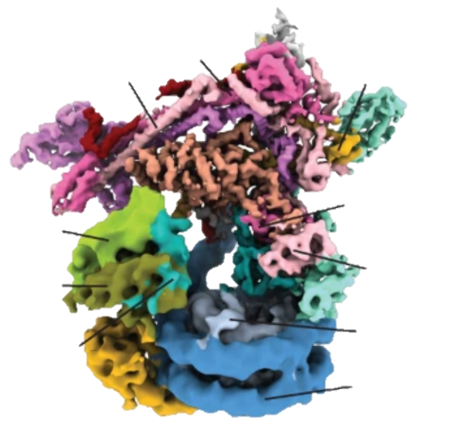
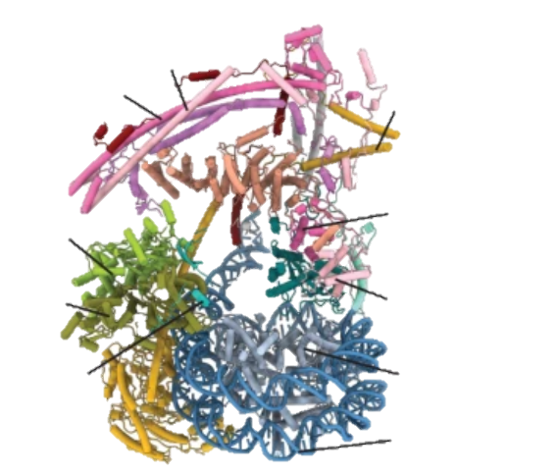
Cryo-EM structure and Protein structure

Slide 10
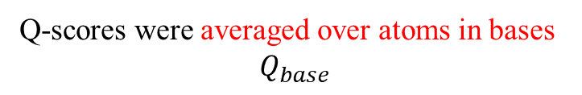
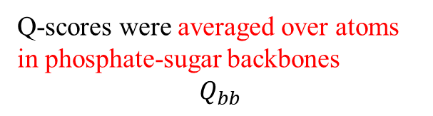
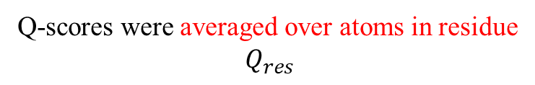
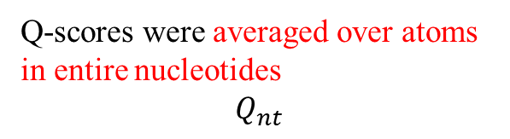
Cryo-EM structure and Protein structure
如何衡量在Protein structure上
每個atom在cryo-EM map上的fitting程度？
Q-scores were averaged over atoms in phosphate-sugar backbones
$$Q_{bb}$$
Q-scores for each atom
如何衡量在Protein structure上
每個residue在cryo-EM map上的fitting程度？
Q-scores were averaged over atoms in entire nucleotides
$$Q_{nt}$$
Q-scores were averaged over atoms in residue
$$Q_{res}$$
Q-scores were averaged over atoms in bases
$$Q_{base}$$

Slide 11
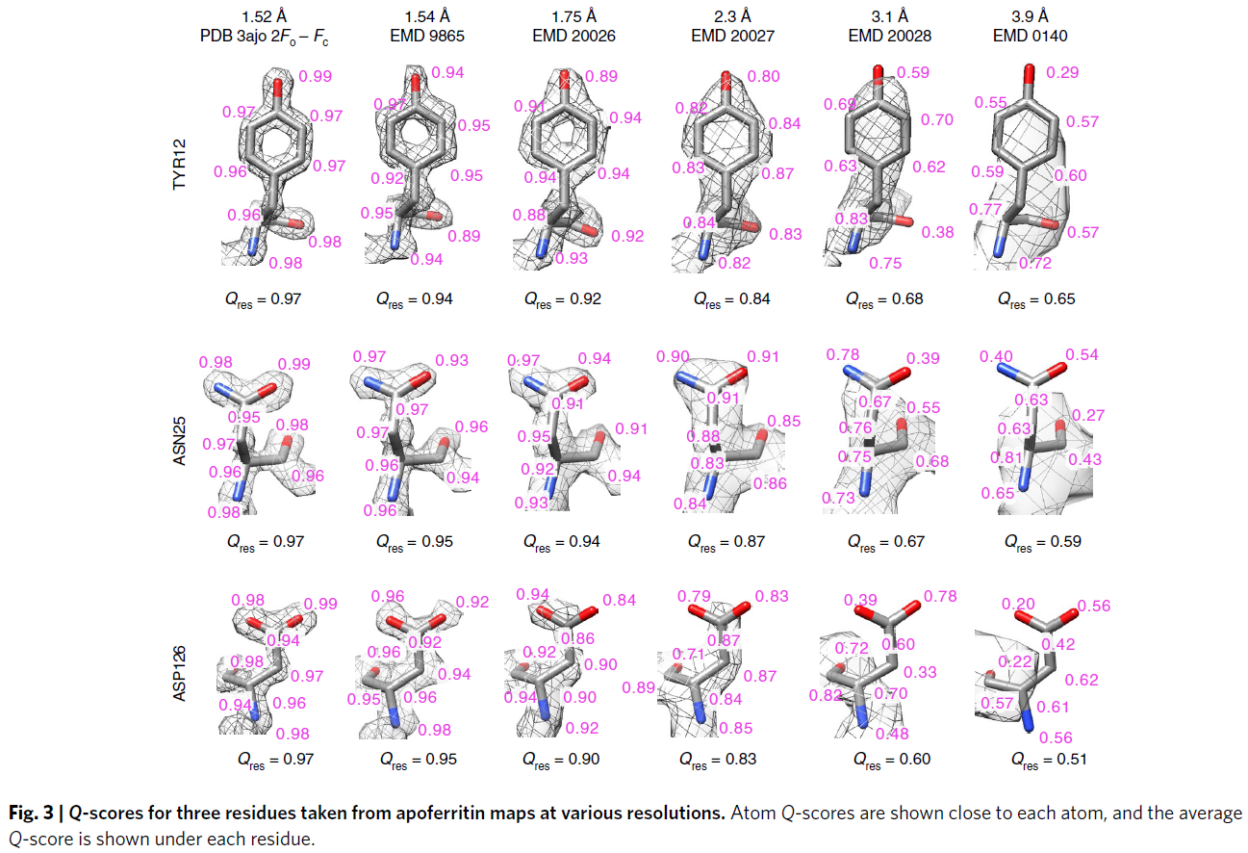

Slide 12
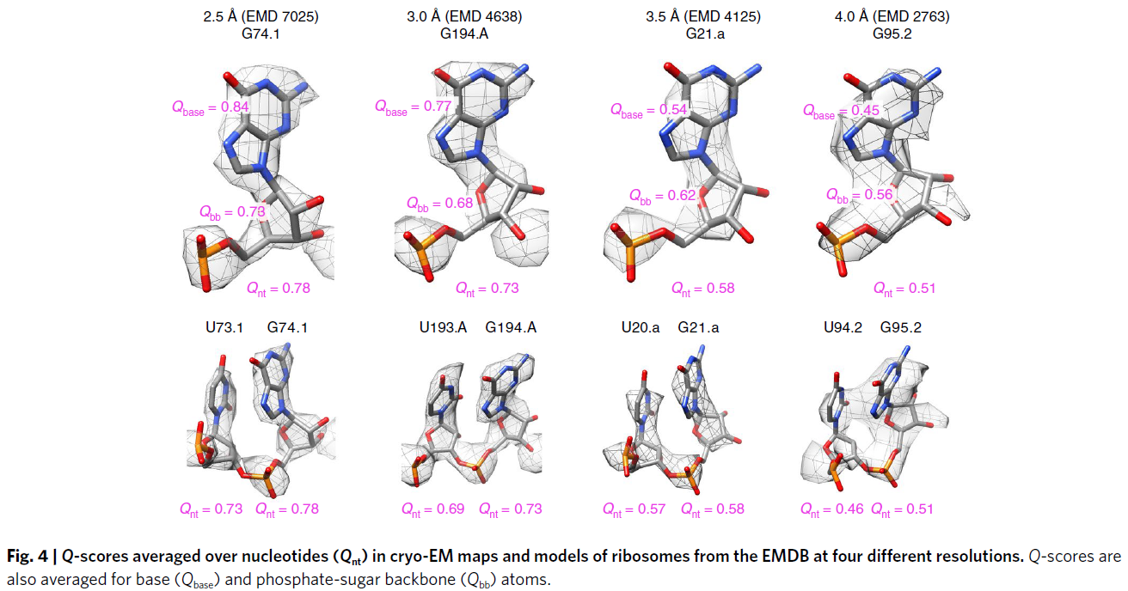

Slide 13
Methods

Slide 14
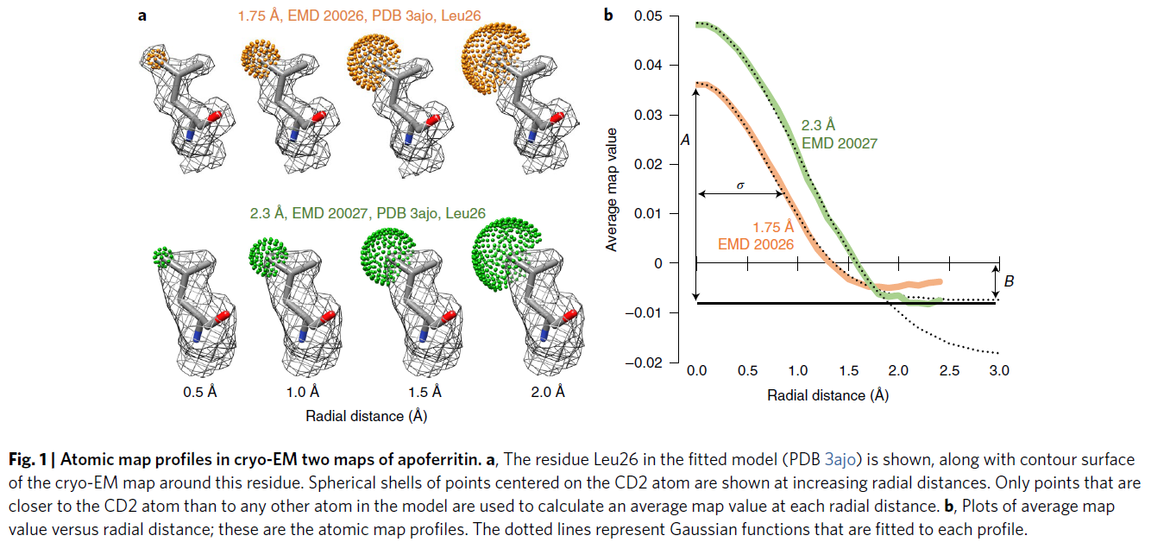
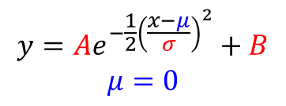
Past 2 Å from the atom,
map profiles observed in these
and other similar resolution cryo-EM maps
become noisy and start to increase.
$$y=Ae^{−\frac{1}{2}{\left(\frac{x−μ}{σ}\right)}^{2}}+B$$
$$μ=0$$
y
x

Slide 15
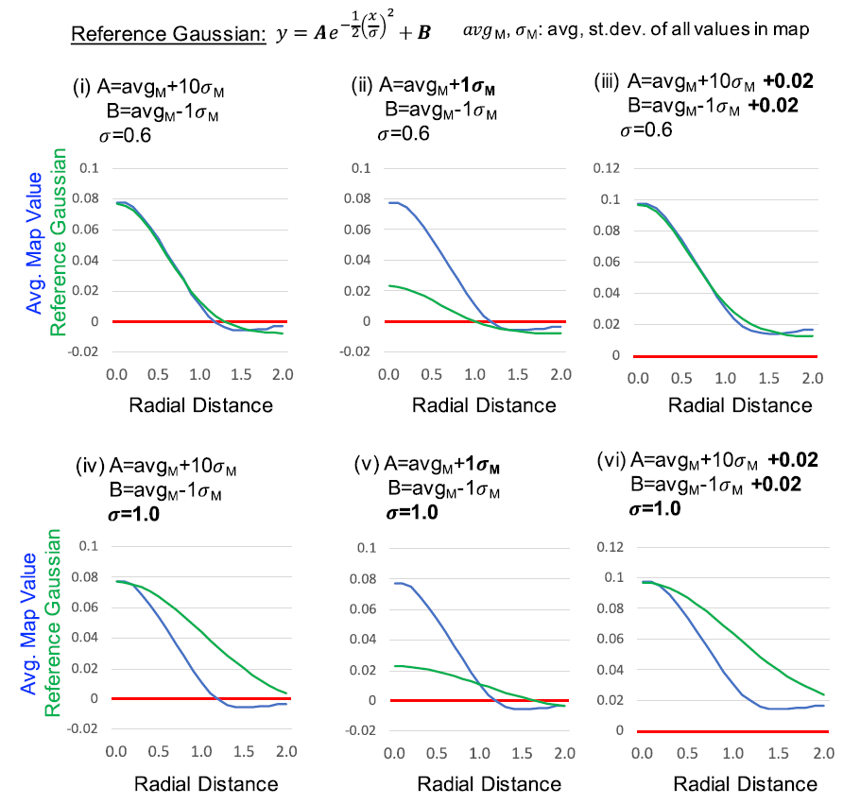
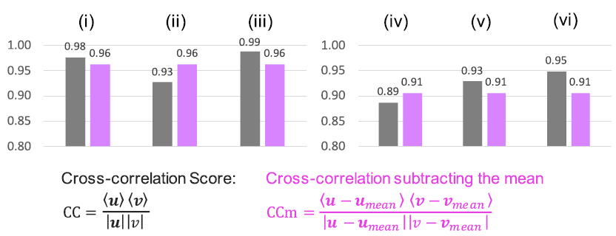
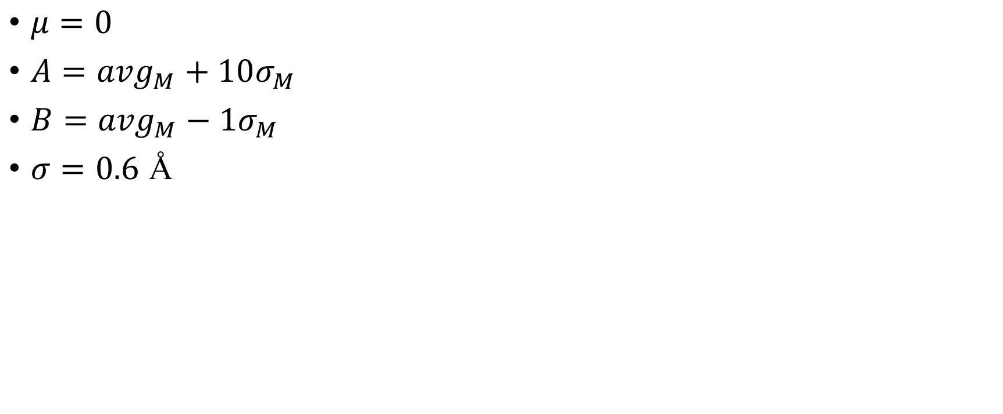
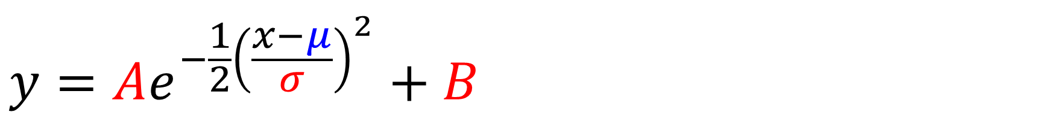
$$y=Ae^{−\frac{1}{2}{\left(\frac{x−μ}{σ}\right)}^{2}}+B$$
$μ=0$
$A={avg}_{M}+10σ_{M}$
$B={avg}_{M}−1σ_{M}$
$σ=0.6$ Å
u
v
Q-score

Slide 16
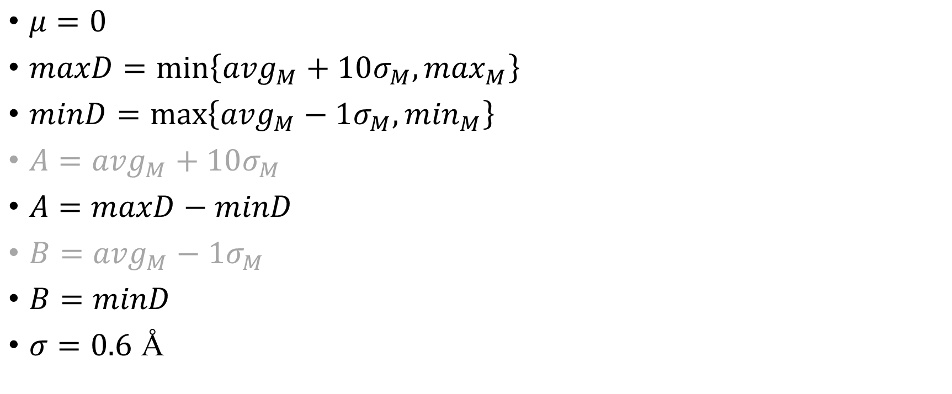
$$y=Ae^{−\frac{1}{2}{\left(\frac{x−μ}{σ}\right)}^{2}}+B$$
Reference Gaussian
$μ=0$
$maxD=\min\left\{{avg}_{M}+10σ_{M}, \max_{M}\right\}$
$minD=\max\left\{{avg}_{M}−1σ_{M}, \min_{M}\right\}$
$A={avg}_{M}+10σ_{M}$
$A=$ $maxD−minD$
$B={avg}_{M}−1σ_{M}$
$B=$ $minD$
$σ=0.6$ Å
u
Code 裡實際寫法
v

Slide 17
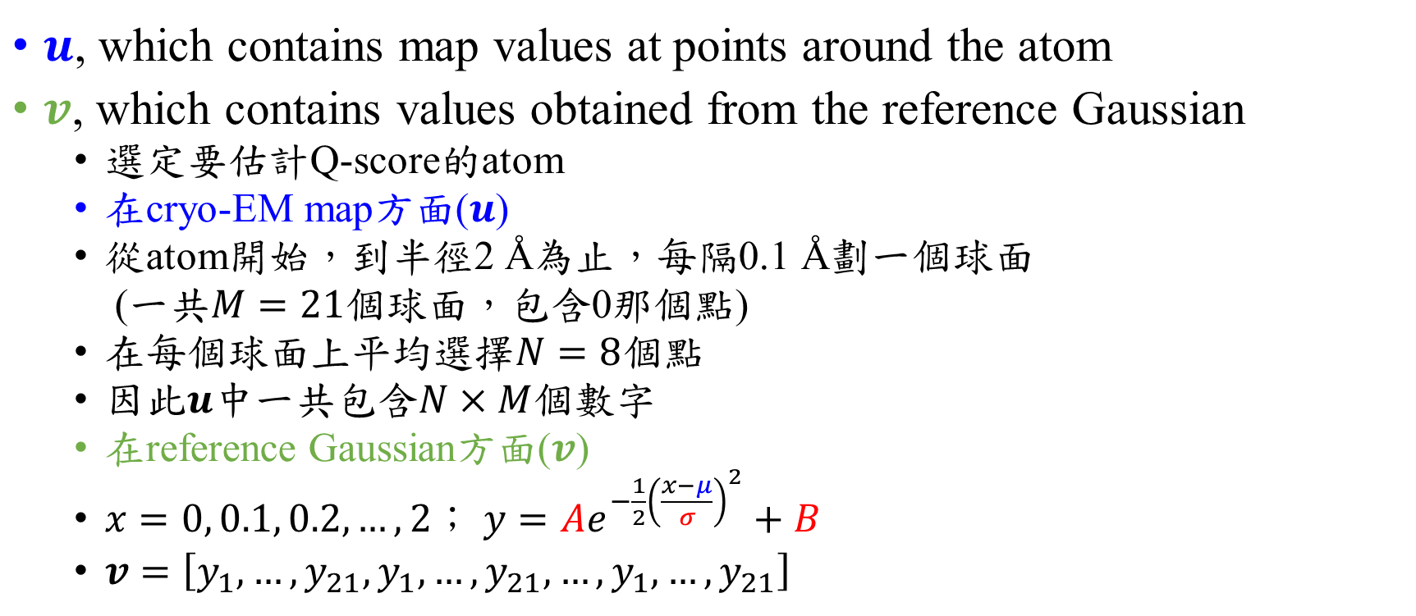
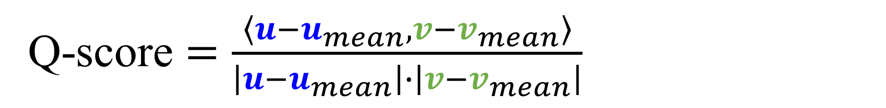
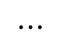
Q-score $=\frac{\left\langle u−u_{mean},v−v_{mean}\right\rangle }{\left|u−u_{mean}\right|∙\left|v−v_{mean}\right|}$
$u$, which contains map values at points around the atom
$v$, which contains values obtained from the reference Gaussian
選定要估計Q-score的atom
在cryo-EM map方面($u$)
從atom開始，到半徑2 Å為止，每隔0.1 Å劃一個球面
(一共$M=21$個球面，包含0那個點)
在每個球面上平均選擇$N=8$個點
因此$u$中一共包含$N×M$個數字
在reference Gaussian方面($v$)
$x=0, 0.1, 0.2, …, 2$； $y=Ae^{−\frac{1}{2}{\left(\frac{x−μ}{σ}\right)}^{2}}+B$
$v=\left[y_{1},…,y_{21},y_{1},…,y_{21},…,y_{1},…,y_{21}\right]$
1
2
$$⋯$$
8

Slide 18
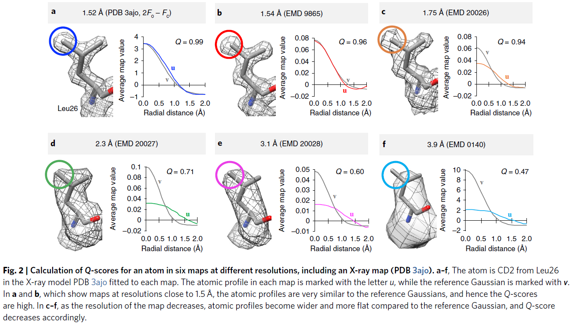

Slide 19
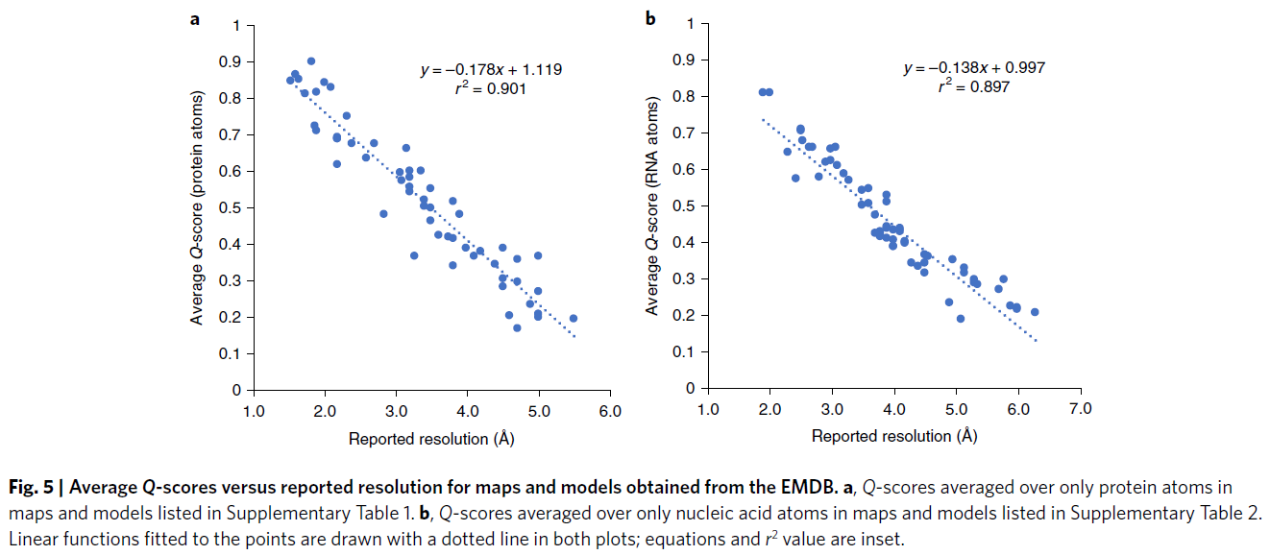

Slide 20
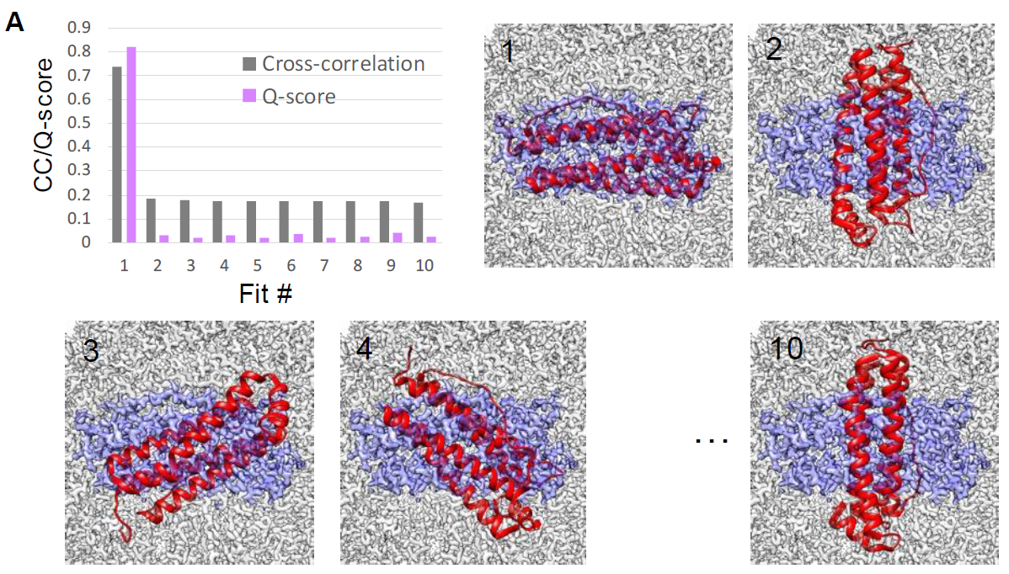

Slide 21
